Slide 1
Module 8 Project
Christopher Morse
CEIS150
10/27/2024

Slide 2
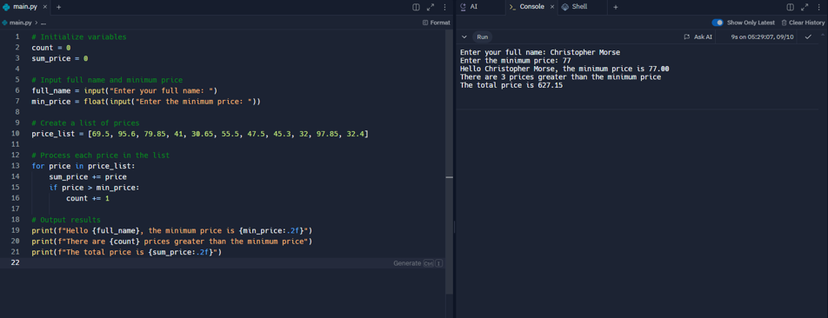
Module 1
In this project I understood more basic understanding of Python functionality and handling my personal inputs.

Slide 3
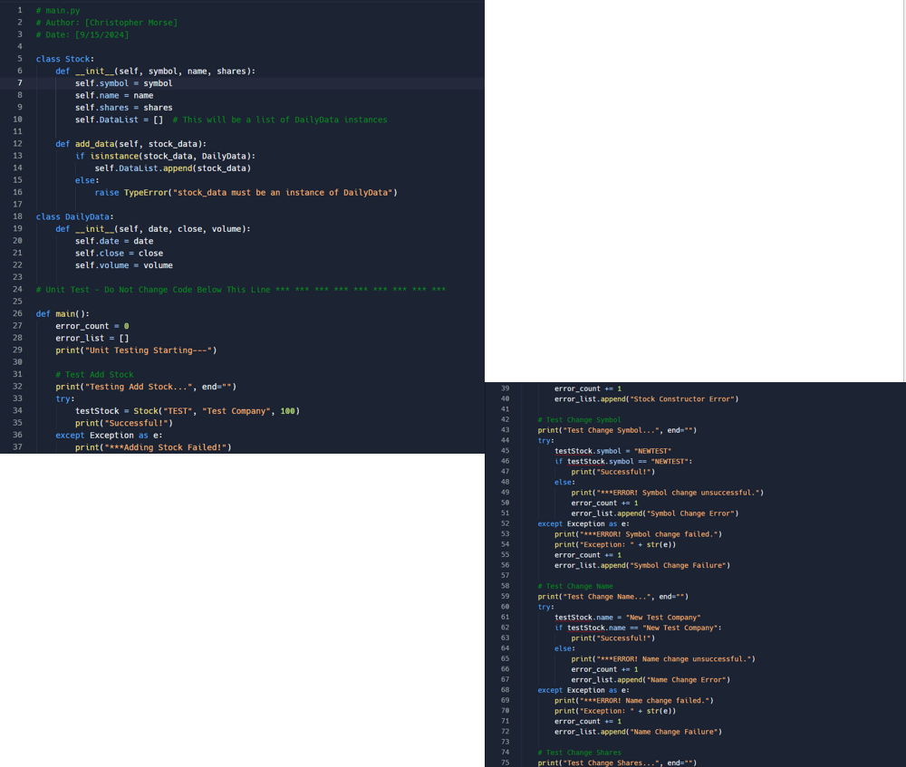
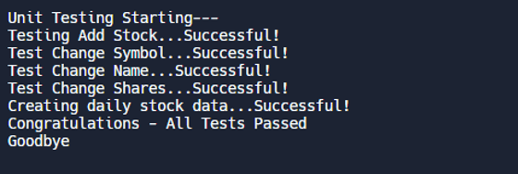
Module 2
This code demonstrates solid foundational knowledge of classes, encapsulation, type checking, and unit testing in Python. You’re not only designing classes with meaningful attributes and methods but also validating their functionality with unit tests, handling errors, and ensuring type safety.

Slide 4
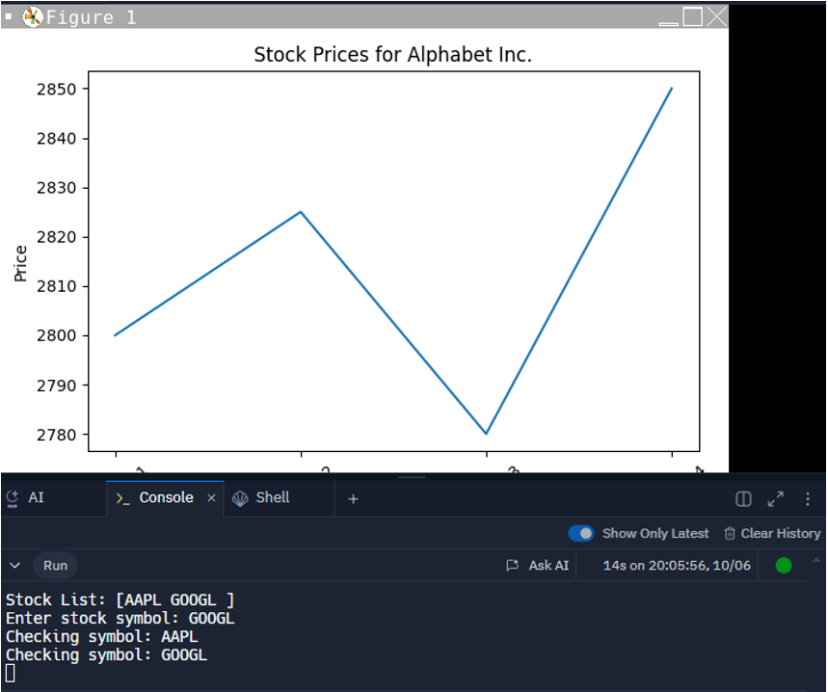
Module 3
This experience shows that I can create visual representations of data using matplotlib, improving the readability of stock price trends. Additionally, I have applied simple input validation by cross-referencing user input with a predefined list.

Slide 5
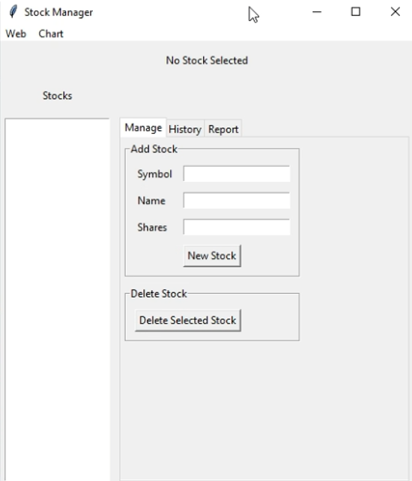
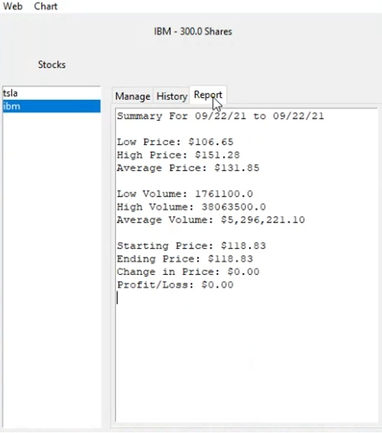
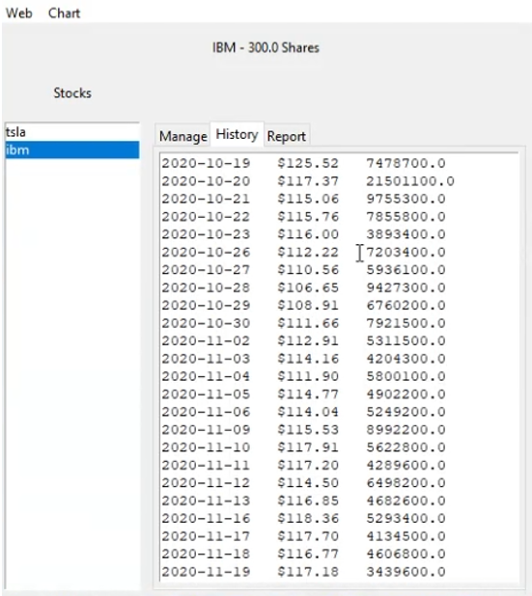
Module 4
During this session I had learned how to show the stocks I have and the history behind each stock.

Slide 6
Career skills
Trouble shooting
Understanding instructions
Coolaberation
Basic python coding.

Slide 7
Conclusion
Completing the CEIS150 class at DeVry has been a rewarding experience that solidified my foundation in Python coding and programming principles. Through practical assignments and projects, I gained valuable insights into essential programming concepts like data types, loops, conditionals, and functions. This course also boosted my confidence in applying these skills to real-world scenarios, providing me with a toolkit I can use in future projects, including my ongoing work with stock tracking applications. The hands-on experience and the knowledge gained have strengthened my problem-solving skills and prepared me for more advanced topics in software development.

